Slide 1
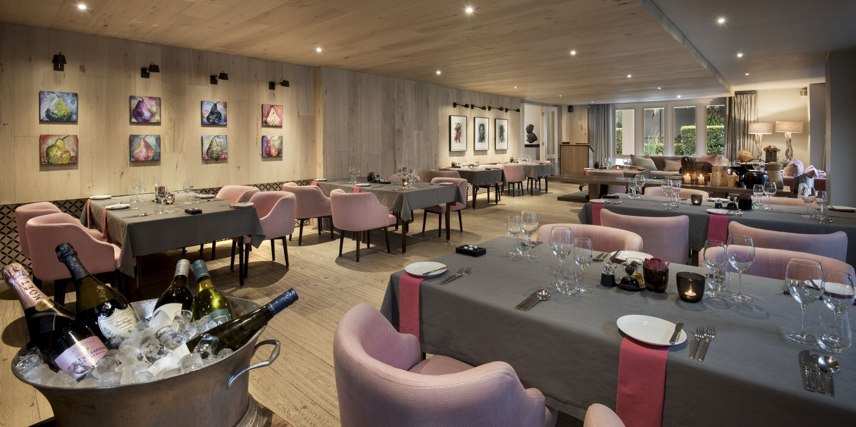

RESTAURANT
SUBMITTED TO:
Ms. ASMITA PANDEY
ASSISTANT PROFESSOR
(DEPARTMENT OF INTELLIGENT SYSTEM)

Slide 2
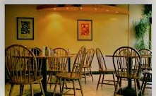
Group Description
This website is strictly under the Copyright of its developers listed below :-
Rahul Shaw (11712434)
Abhishek Anand (11712449)
Anant Srivastava (11712494)
Riya Garg (11712416)

Slide 3
Background
A restaurant or an eatery, is a business which prepares and serves food and drinks to customers in exchange for money.
It has long been accepted that the first establishments that we would consider “Restaurants” originated in Paris in the mid-eighteenth century.
The history of the restaurant’s development in the eighteenth century and into the nineteenth century , when it became the institution that we would recognize today , is a complex one.

Slide 4
objectives
The objective is to provide user :
Information about the restaurants available in the cities, the famous ones.
Menu List of different categories without moving around physically.
Facility to give order in advance for any occasion of his required Menu items on restaurant specified time.
Remarks on the particular restaurant given by others.
Pictures of interiors of restaurants.

Slide 5
Work Division
Rahul Shaw- I worked on the login and sign up page using javascript and css .
Abhishek Anand- I worked on the proper implementation of the codes . I worked on home page and menu bar. I used bootstrap and awesome fonts for more attaractive look.
Anant Srivastava-. I worked on design, template of the website. I worked on the home page also. I worked on the contact us page.
Riya Garg- I basically worked on creating dropdown menus. I worked on the review page. I worked on I’m Hungry page.

Slide 6

Let’s Go

Slide 7
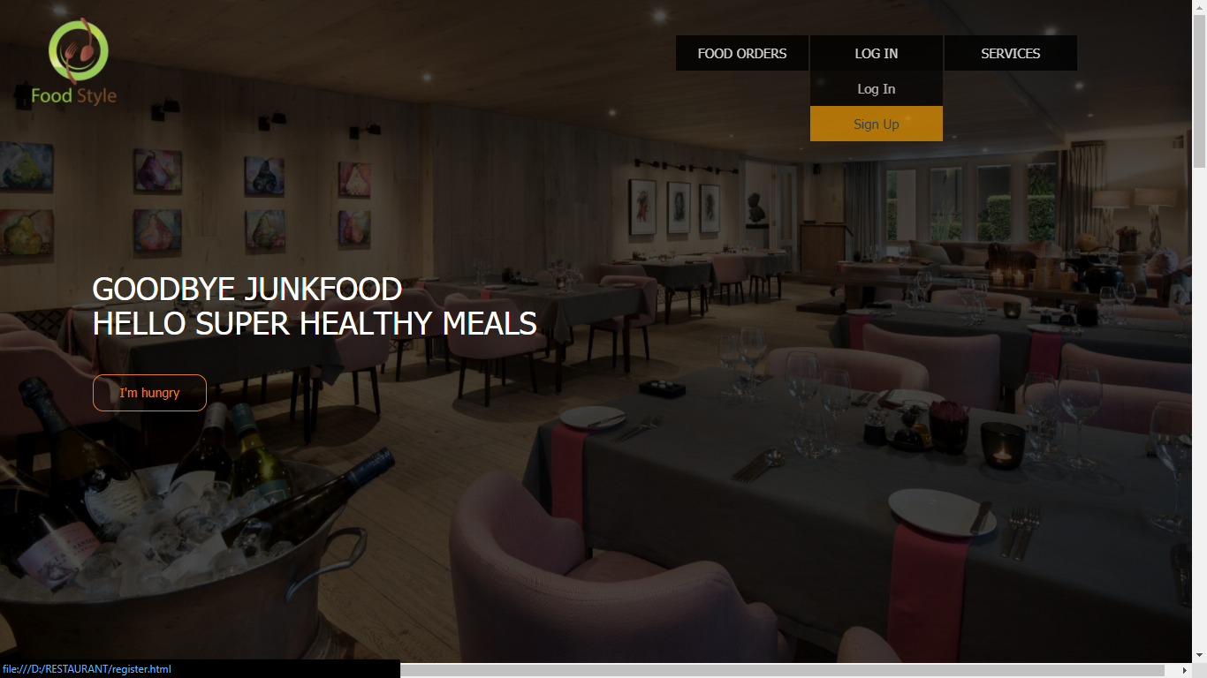
HOME PAGE

Slide 8
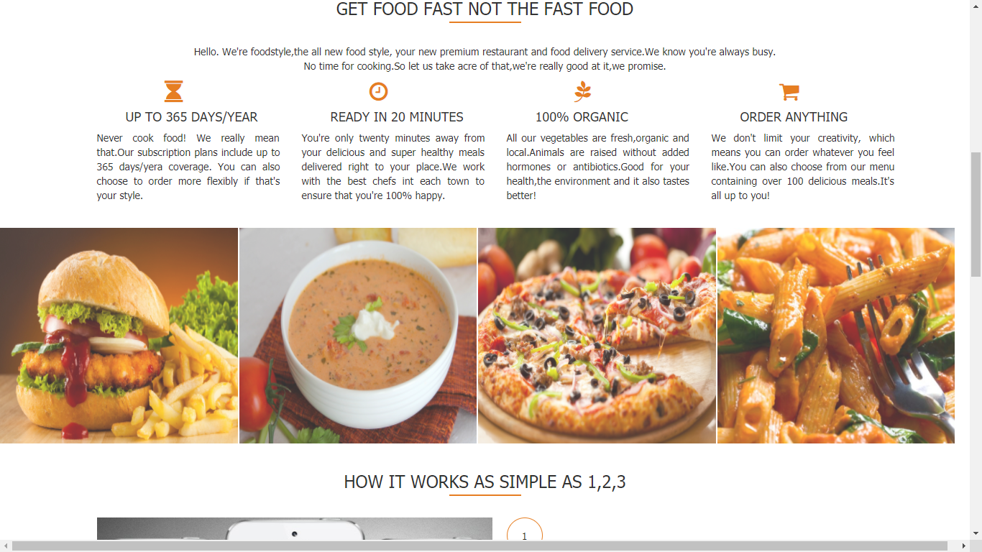

Slide 9
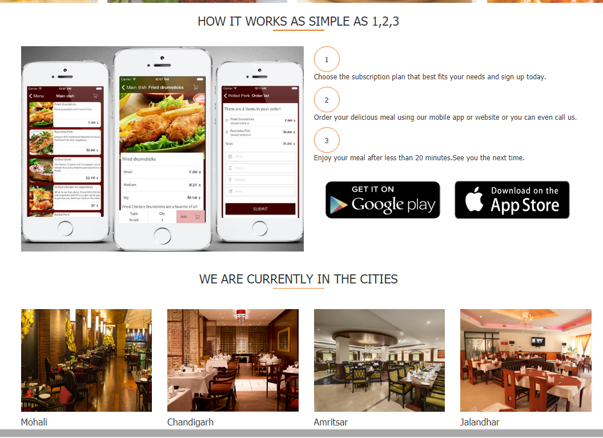

Slide 10
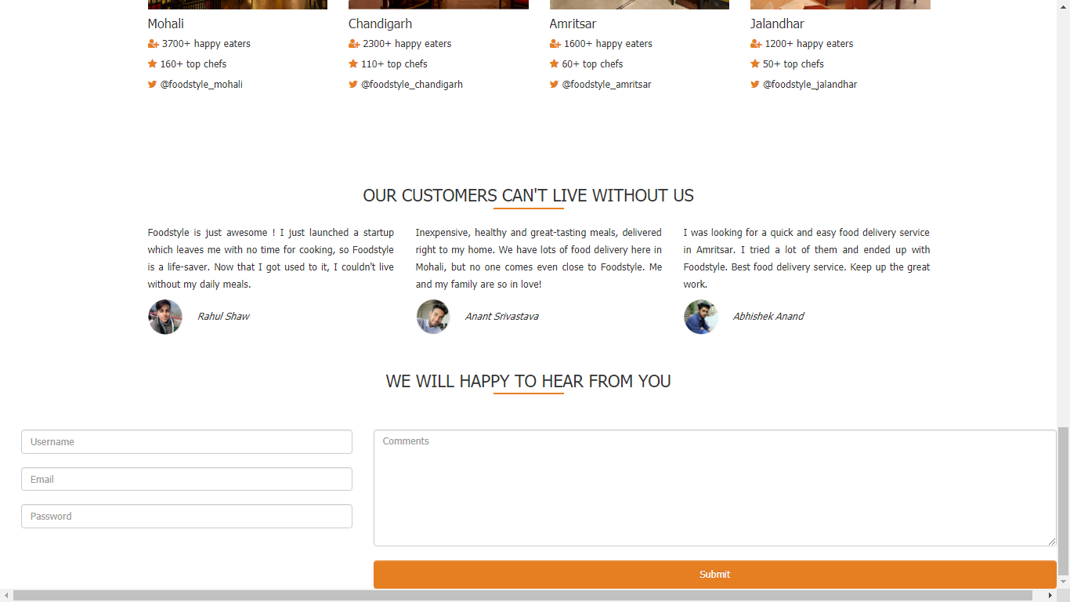

Slide 11
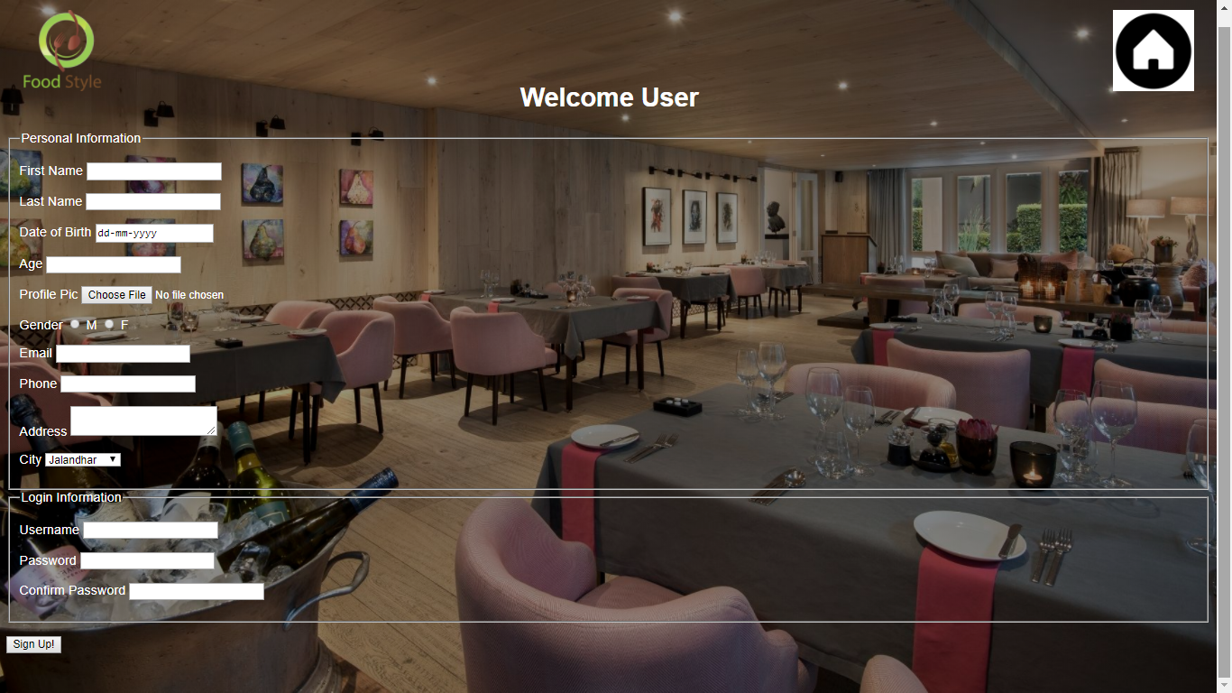
Sign up page

Slide 12
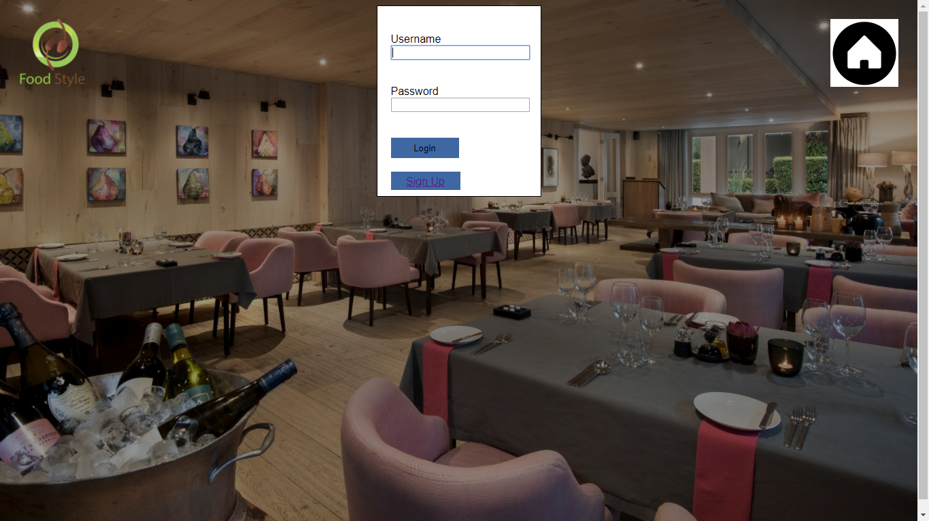
Login page

Slide 13
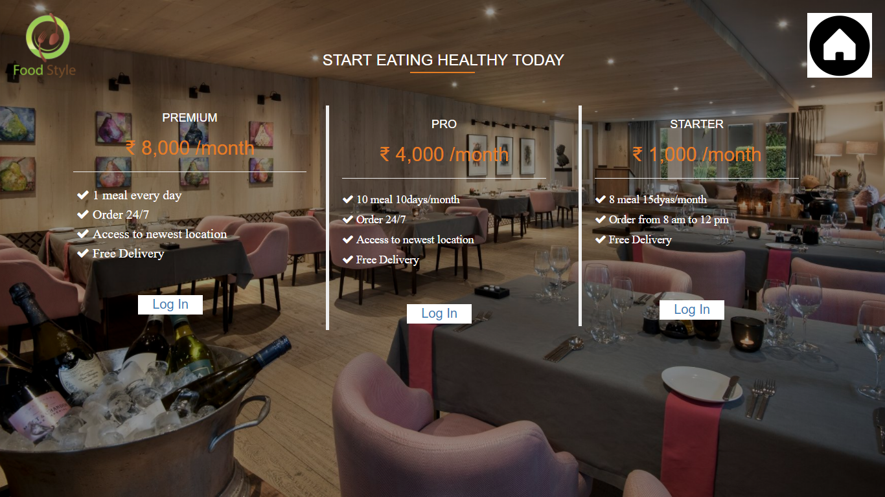
Take a plan page

Slide 14
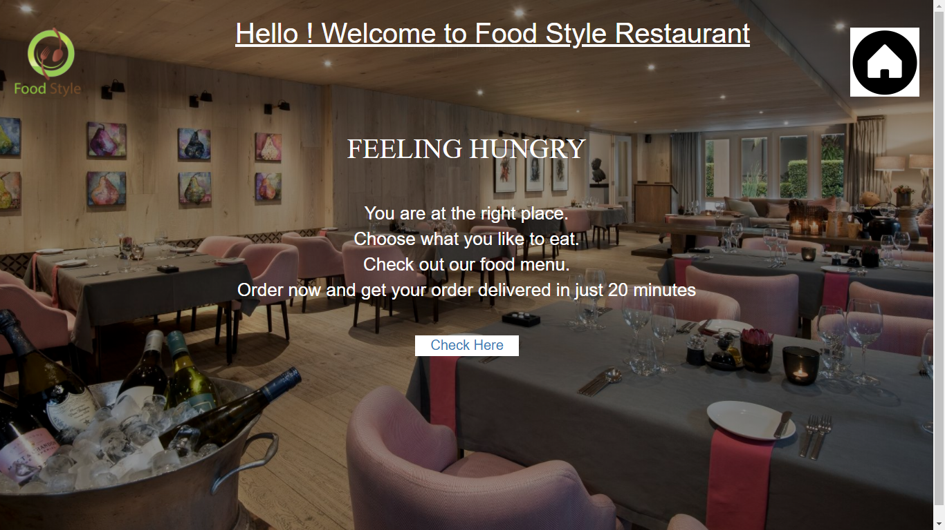
Feeling hungry ??

Slide 15
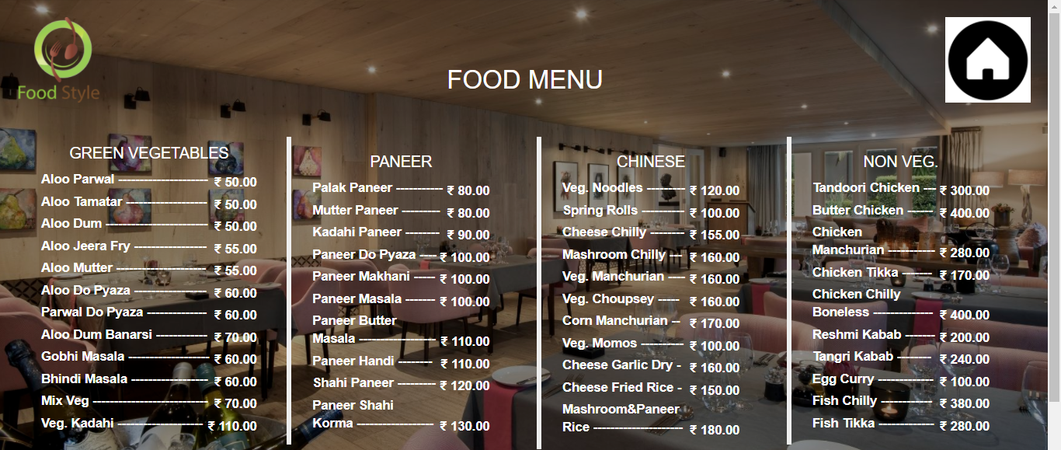
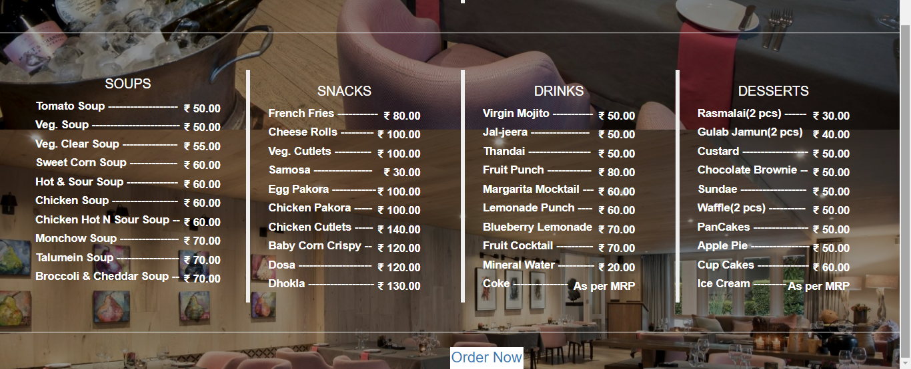
Menu page

Slide 16
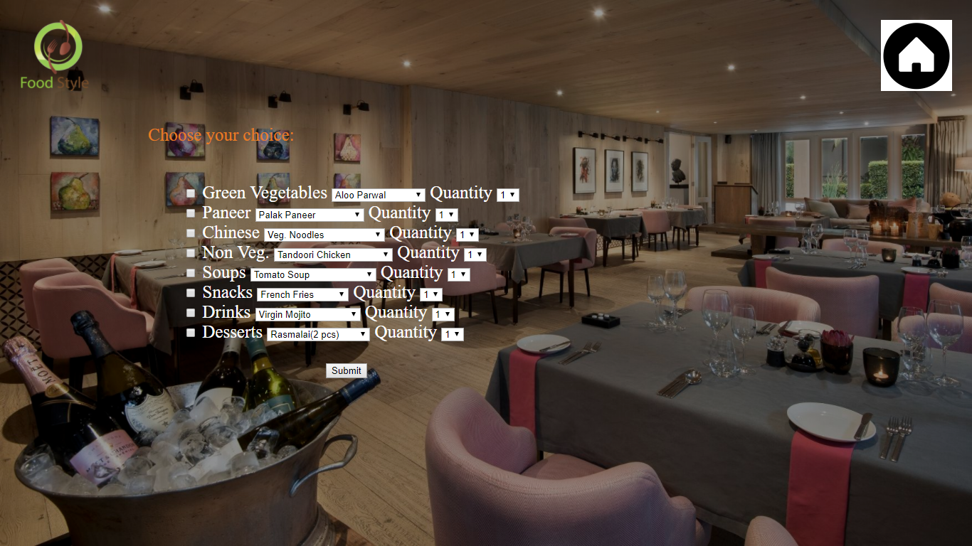
Final Order Page

Slide 17
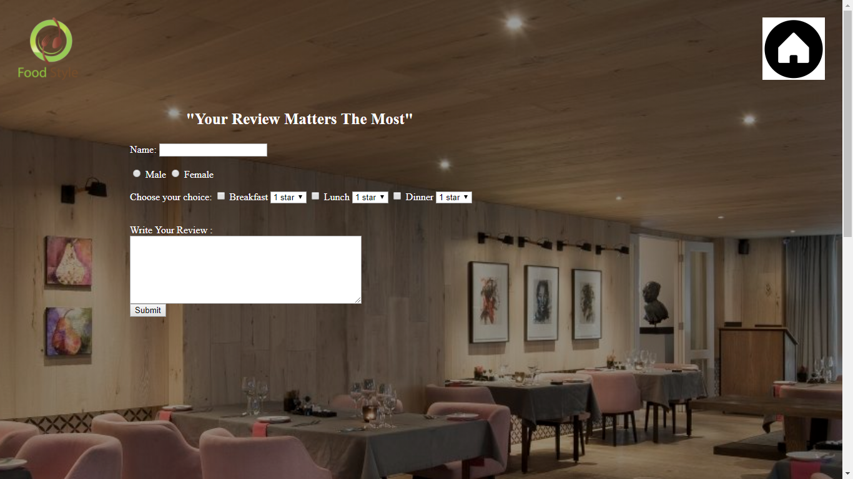
Review page

Slide 18
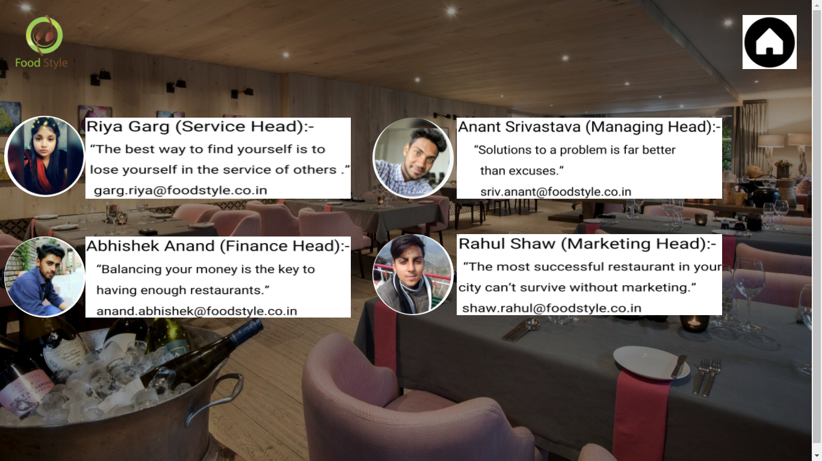
Contact-us page

Slide 19
Thank you
…….

